Slide 1

Highres BioSolutions Programming Challenge
Nick Hinchliffe

Slide 2
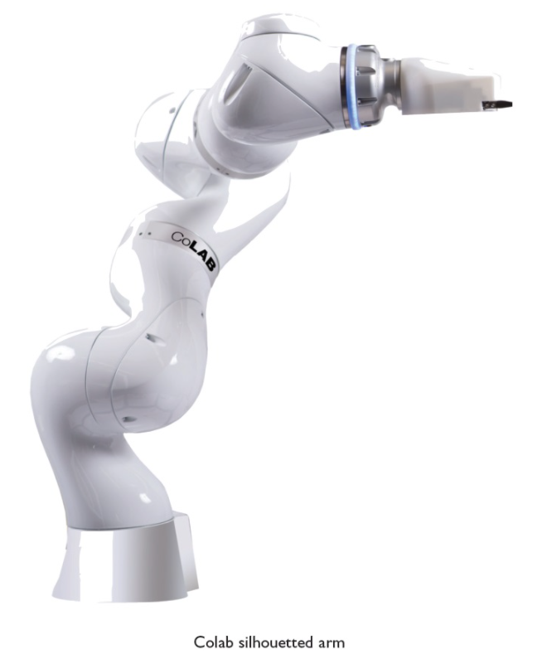
Problem Description
Implement DeviceDriver:
OpenConnection(string IPAddress)
Initialize()
ExecuteOperation(string operation, string[] parameterNames, string[] parameterValues)
Abort()
Notes:
Problem Description: Implement a DeviceDriver which will allow a user to control a MockRobot by a set of specified commands. User will press a button mapped to one of the DeviceDriver functions after typing in any needed parameters.
OpenConnection -> Create TCP/IP connection between UI and MockRobot through the DeviceDriver.
Initialize -> Put MockRobot into an automation-ready (homed) state.
ExecuteOperation -> DeviceDriver will perform an operation determined by the parameter operation
Can be: Pick, Place, and Transfer.
Abort -> Expects that DeviceDriver will terminate communication with the MockRobot.

Slide 3
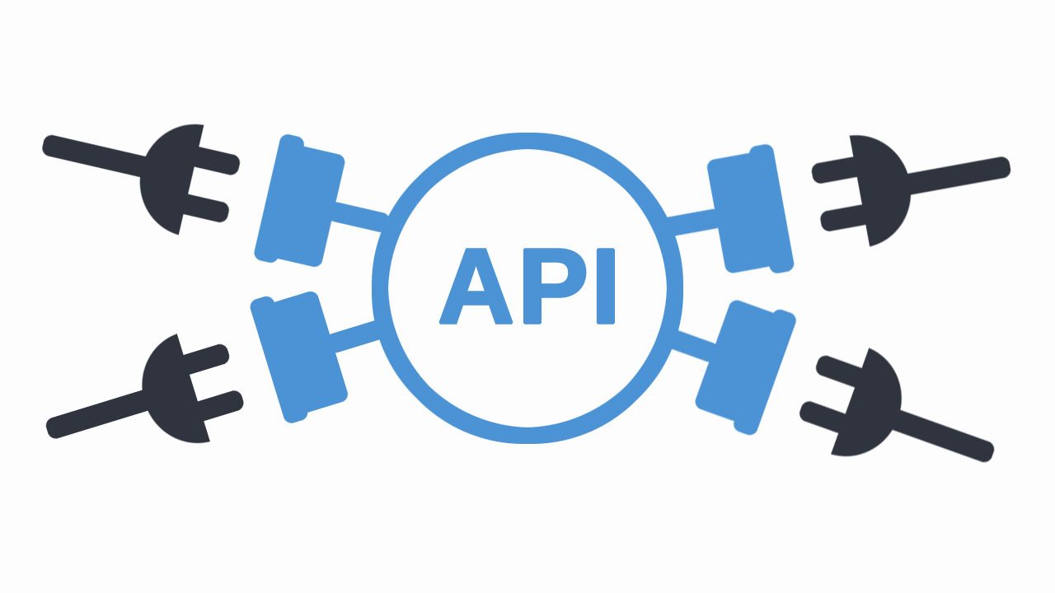
MockRobot Device API
Given accepted commands:
home
pick
place
status
Notes:
These API commands are how the DeviceDriver interacts with the robot.
These are given, the robot will understand them when they are given as a string with a % sign before any parameters.
Home puts the robot in a homed, automation ready state
Pick will pick up an object from a given Source location, int parameter
Place will place an object which the Robot will already be holding at a Destination location, int parameter
Status checks the status of command specified by it’s PID. Will return: In Progress, Finished Successfully, and or Terminated with Error

Slide 4
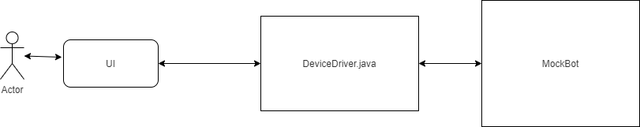
System Architecture
Client Server Architecture

Slide 5

Implementation
Methods:
OpenConnection(String IPAddress)
Abort()
Initialize()
checkInitResults(int initPid, String res)
checkBot(int pid)
ExecuteOperation(string operation, string[] parameterNames, string[] parameterValues)
pick/place(string location, string res, int pid, string lastOperation)
transfer(string[] parameterNames, string[] parameterValues, string res, int pid, string lastOperation)
isValid(string operation, string[] parameterNames, string[] parameterValues)
checkMockBotStatus(int pid, String res)
checkBot(int pid)

Slide 6
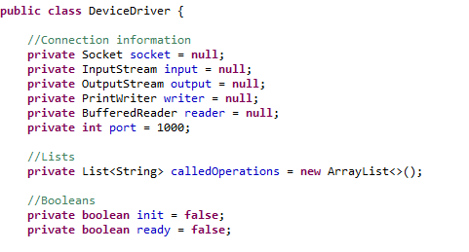
“Global” variables
Private
Non static
Null, false, or empty
Accessible

Slide 7
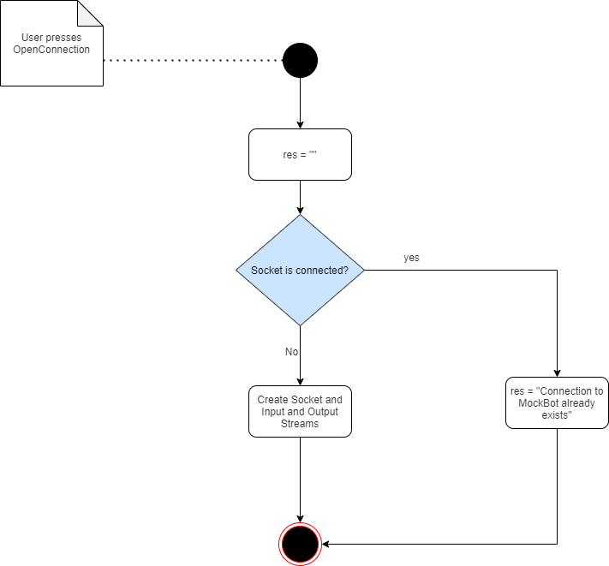
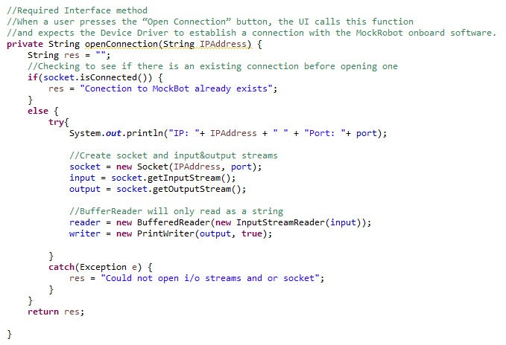
Open Connection

Slide 8
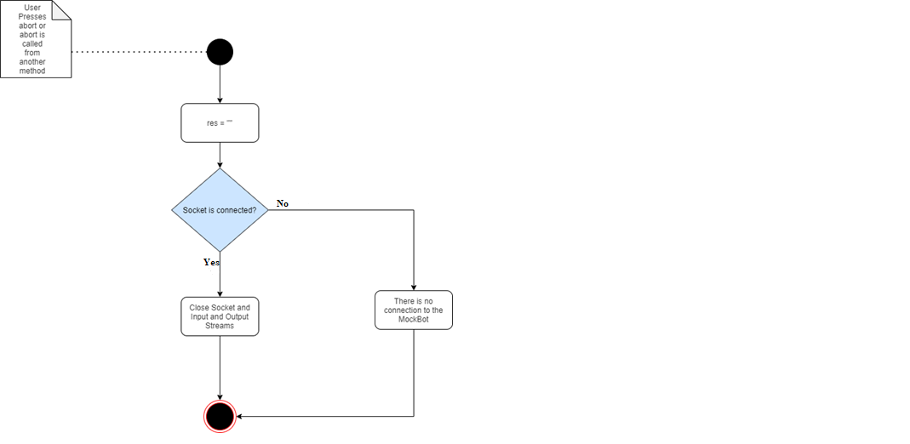
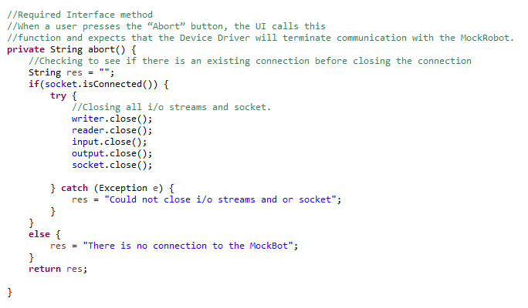
Abort

Slide 9
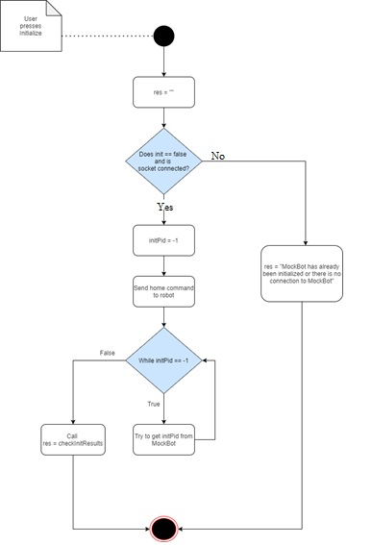
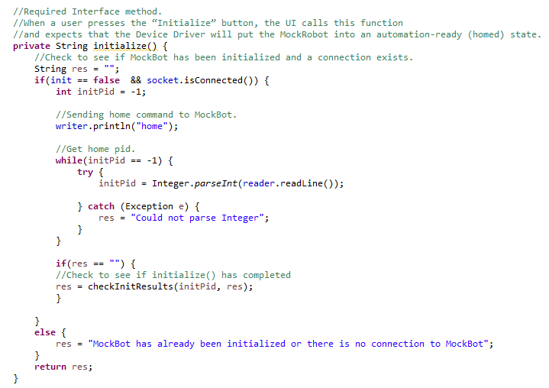
Initialize

Slide 10
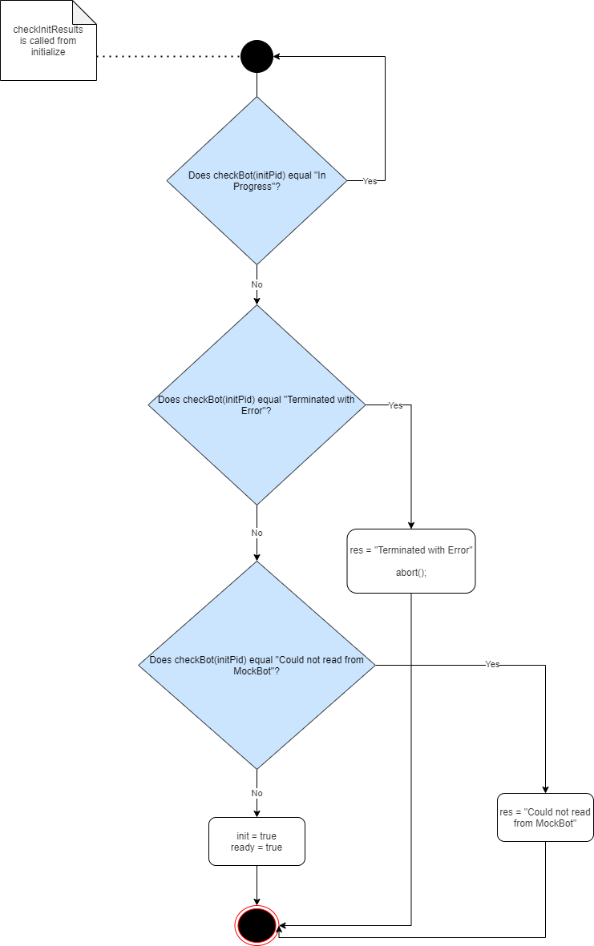
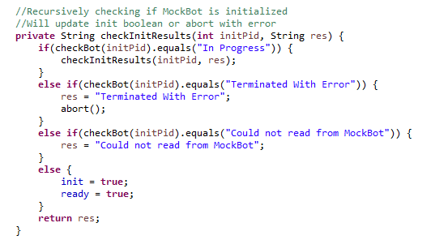
Check Init Results

Slide 11
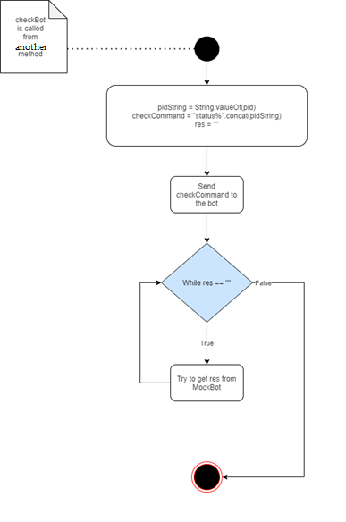
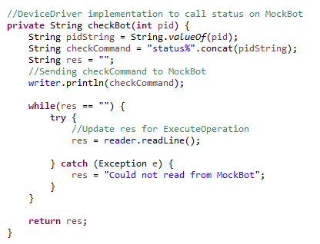
Check bot

Slide 12
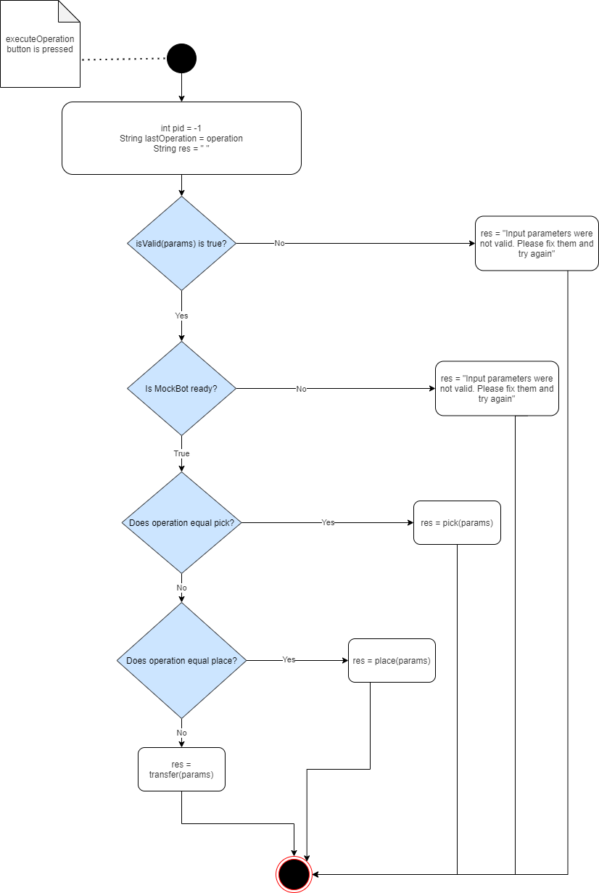
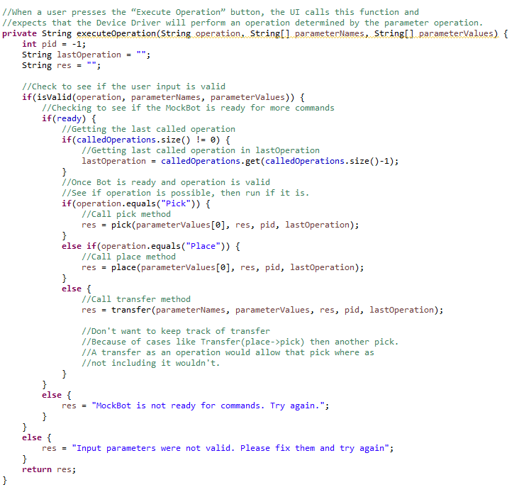
Execute operation

Slide 13
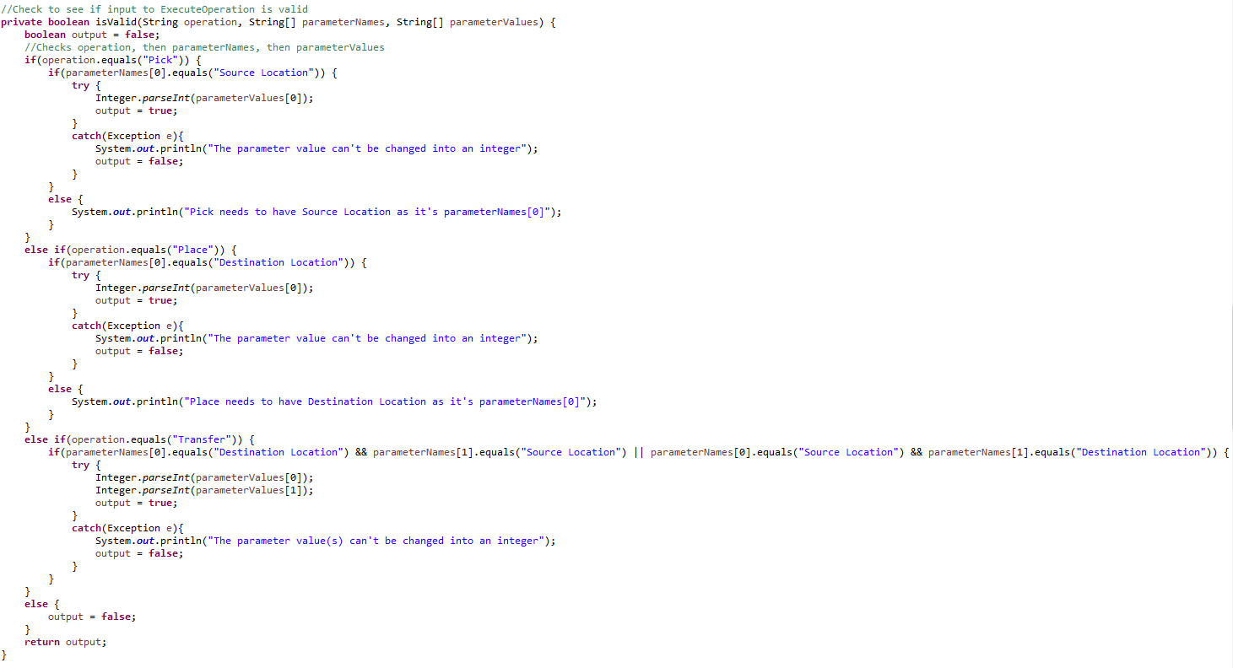
iS Valid

Slide 14
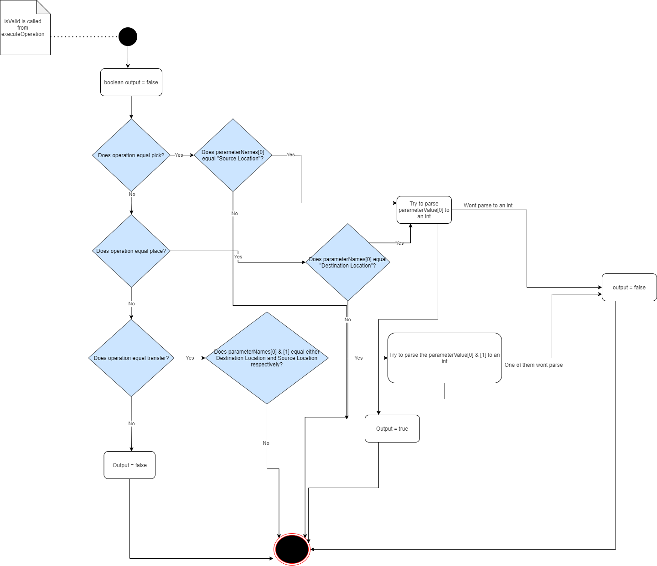
iS Valid Activity Diagram

Slide 15
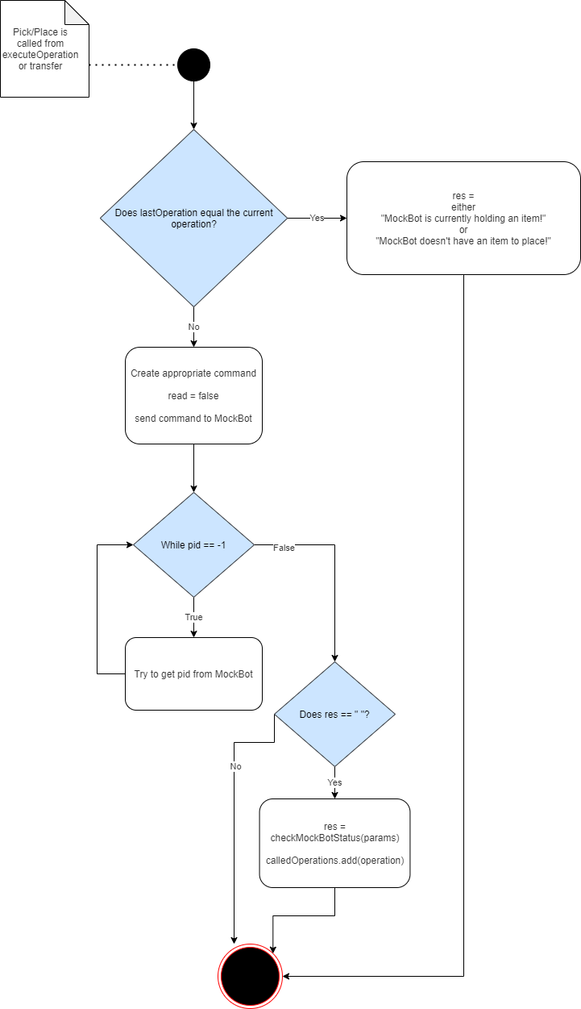
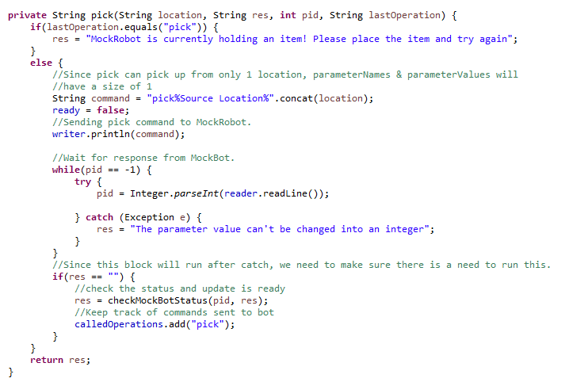
Pick & place

Slide 16
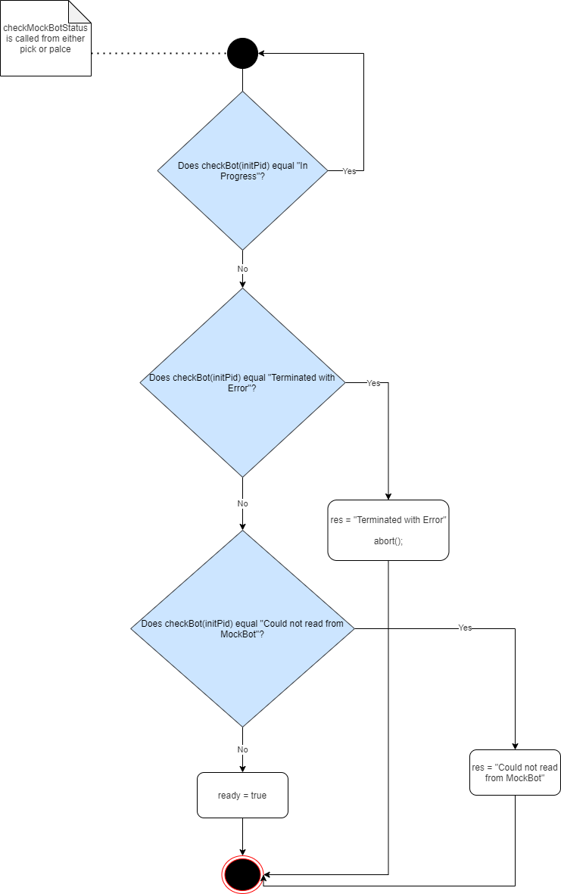
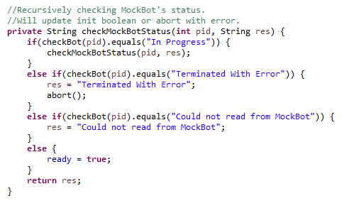
Check mock Bot status

Slide 17
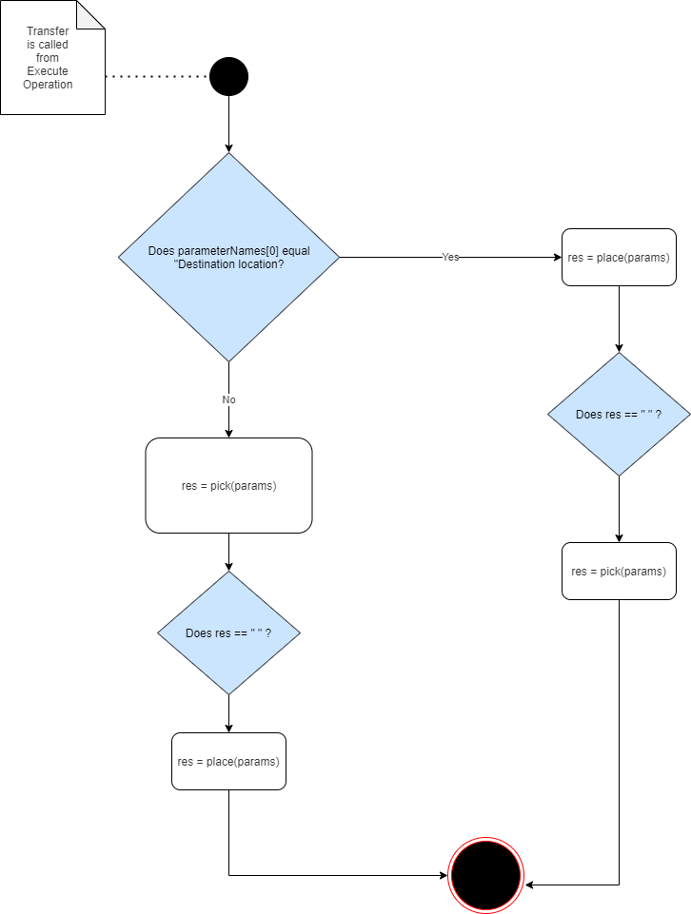
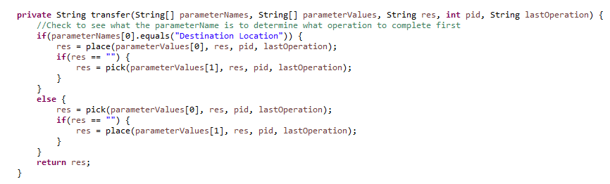
Transfer

Slide 18

challenges
Time Management
Depth of Project
Reviewing Socket Programming in Java
Creating logic for checking Bot

Slide 19

Future improvements
Implement methods as boolean
Create a MockBot
Finding a better way to get pid from Mockbot
More dynamic code
Notes:
Have enum to return codes from

Slide 20

Lessons Learned
More about Automation Engineer Position
Logic behind robot automation
Socket Programming in java
Improved prioritizing skills
Notes:
Have enum to return codes from

Slide 21

Conclusion
Notes:
Automation Engineer

Slide 22
Questions?

Slide 23
Image sources
https://www.titian.co.uk/highres-biosolutions
https://medium.com/@sgg2123/apis-and-ruby-7675144f3391
https://medium.com/corda/how-to-develop-a-blockchain-application-if-you-only-know-java-f93dcf52cb60
https://knowlab.in/dont-limit-your-challenges-challenge-your-limits/
https://digest.bps.org.uk/2018/03/21/is-the-future-ahead-not-for-those-born-blind/
https://www.sourcecon.com/closing-out-2018-with-lessons-learned-on-the-job/
https://twitter.com/highresbio
Notes:
Automation Engineer

